Slide 1
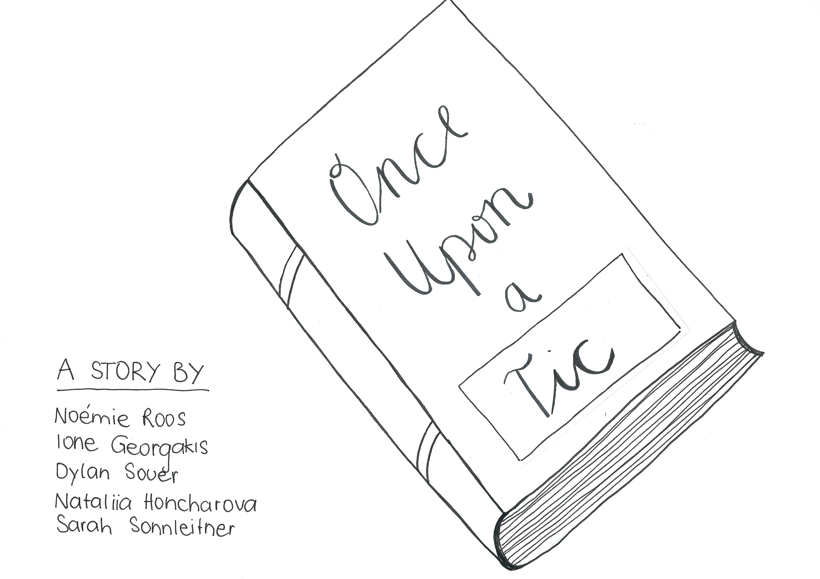
Notes:
This is the journey of a young girl Alice, transitioning from primary to secondary school, and looks at some of the difficulties she faces in this journey, and the support she receives to make the process more manageable. In our story Alice and her mother use the resources from Tourettes Action to educate both her teachers and peers on her condition, to help improve her time in school.
This presentation was created by students of international interdisciplinary program – COHERE which focuses on Diversity and Social Inclusion, hosted by Rotterdam University.

Slide 2
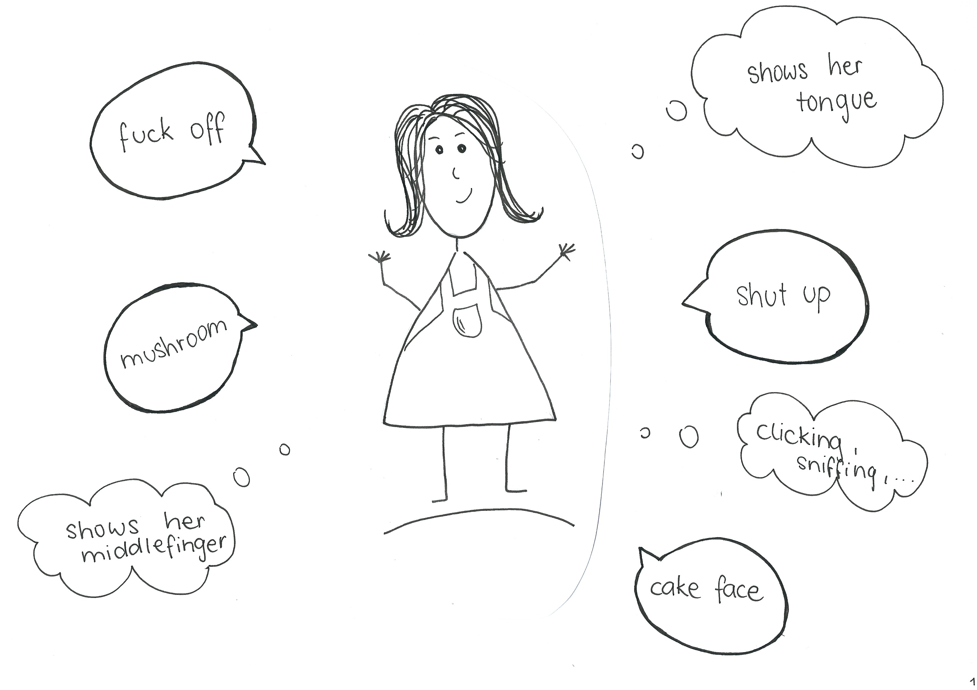
Notes:
Narrator: Meet Alice, she is 12 years old and has Tourette syndrome. Tourette’s is a neurological condition that causes people to make involuntary sounds and movements. Alice was diagnosed with Tourette's 5 years ago when she was in primary school. It was a very difficult time in her life, she was coming to terms with her tics and the impact they have on her life. Today is Alice’s first day of secondary school, let’s see how her day went.

Slide 3
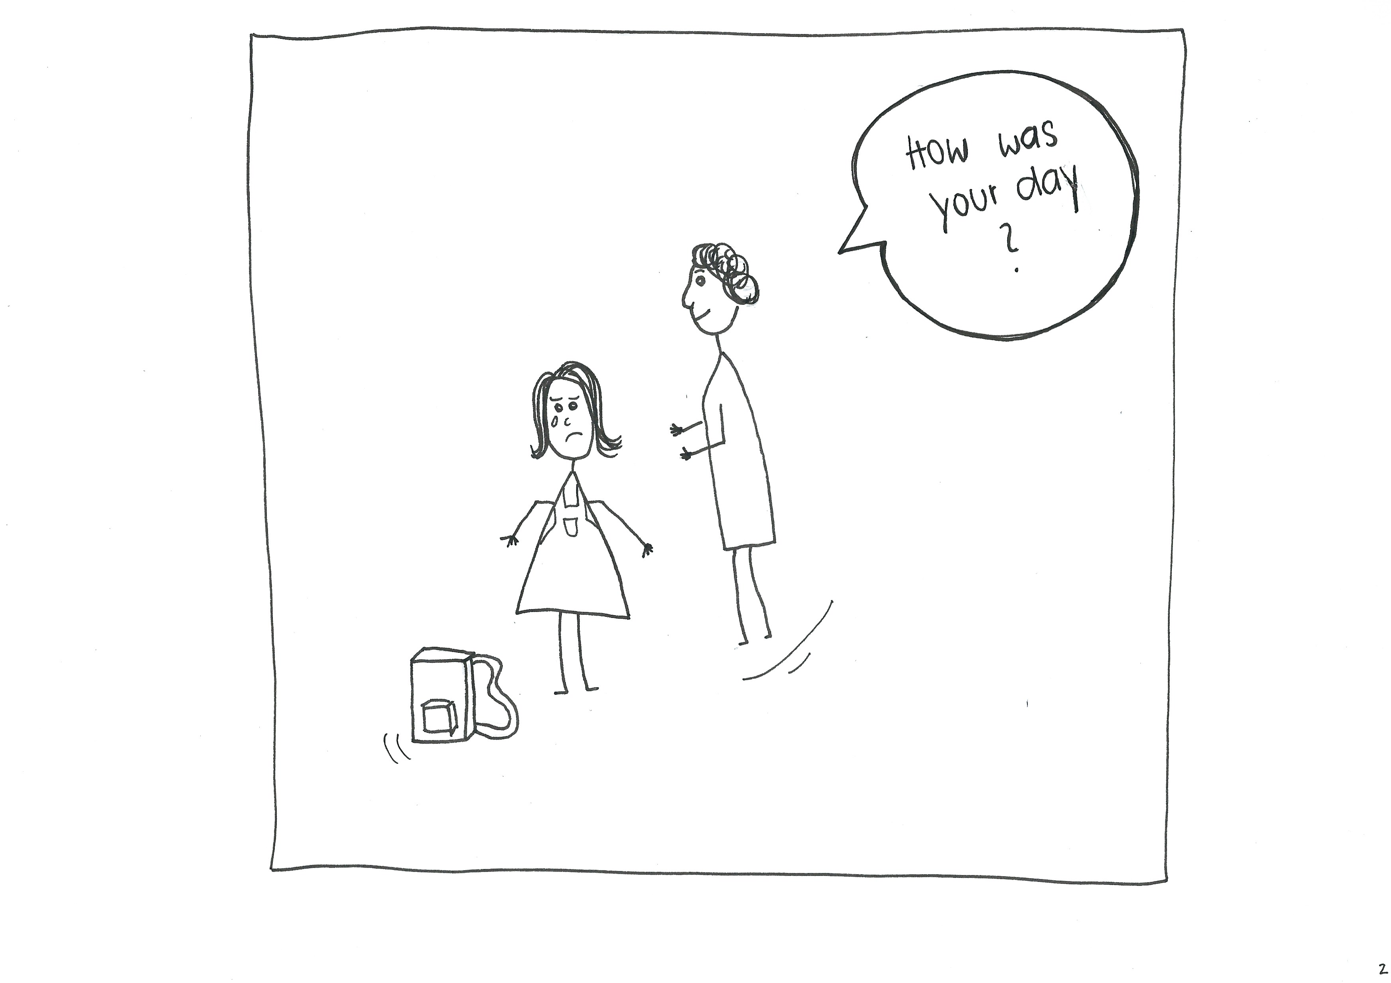
Notes:
Mum: How was your day dear?
Alice: It was bloody terrible mum, I know we told the school, but the teachers just didn’t get it, Susan isn’t in my class, I have no friends, I called the lunch lady a wizard lover and couldn’t concentrate at all. Everyone in the class thought I was being weird and made fun of me, I tried to hold in my tics but in the end, I gave a boy the middle finger and shouted ‘boring’. I don’t want to go back ever again!

Slide 4
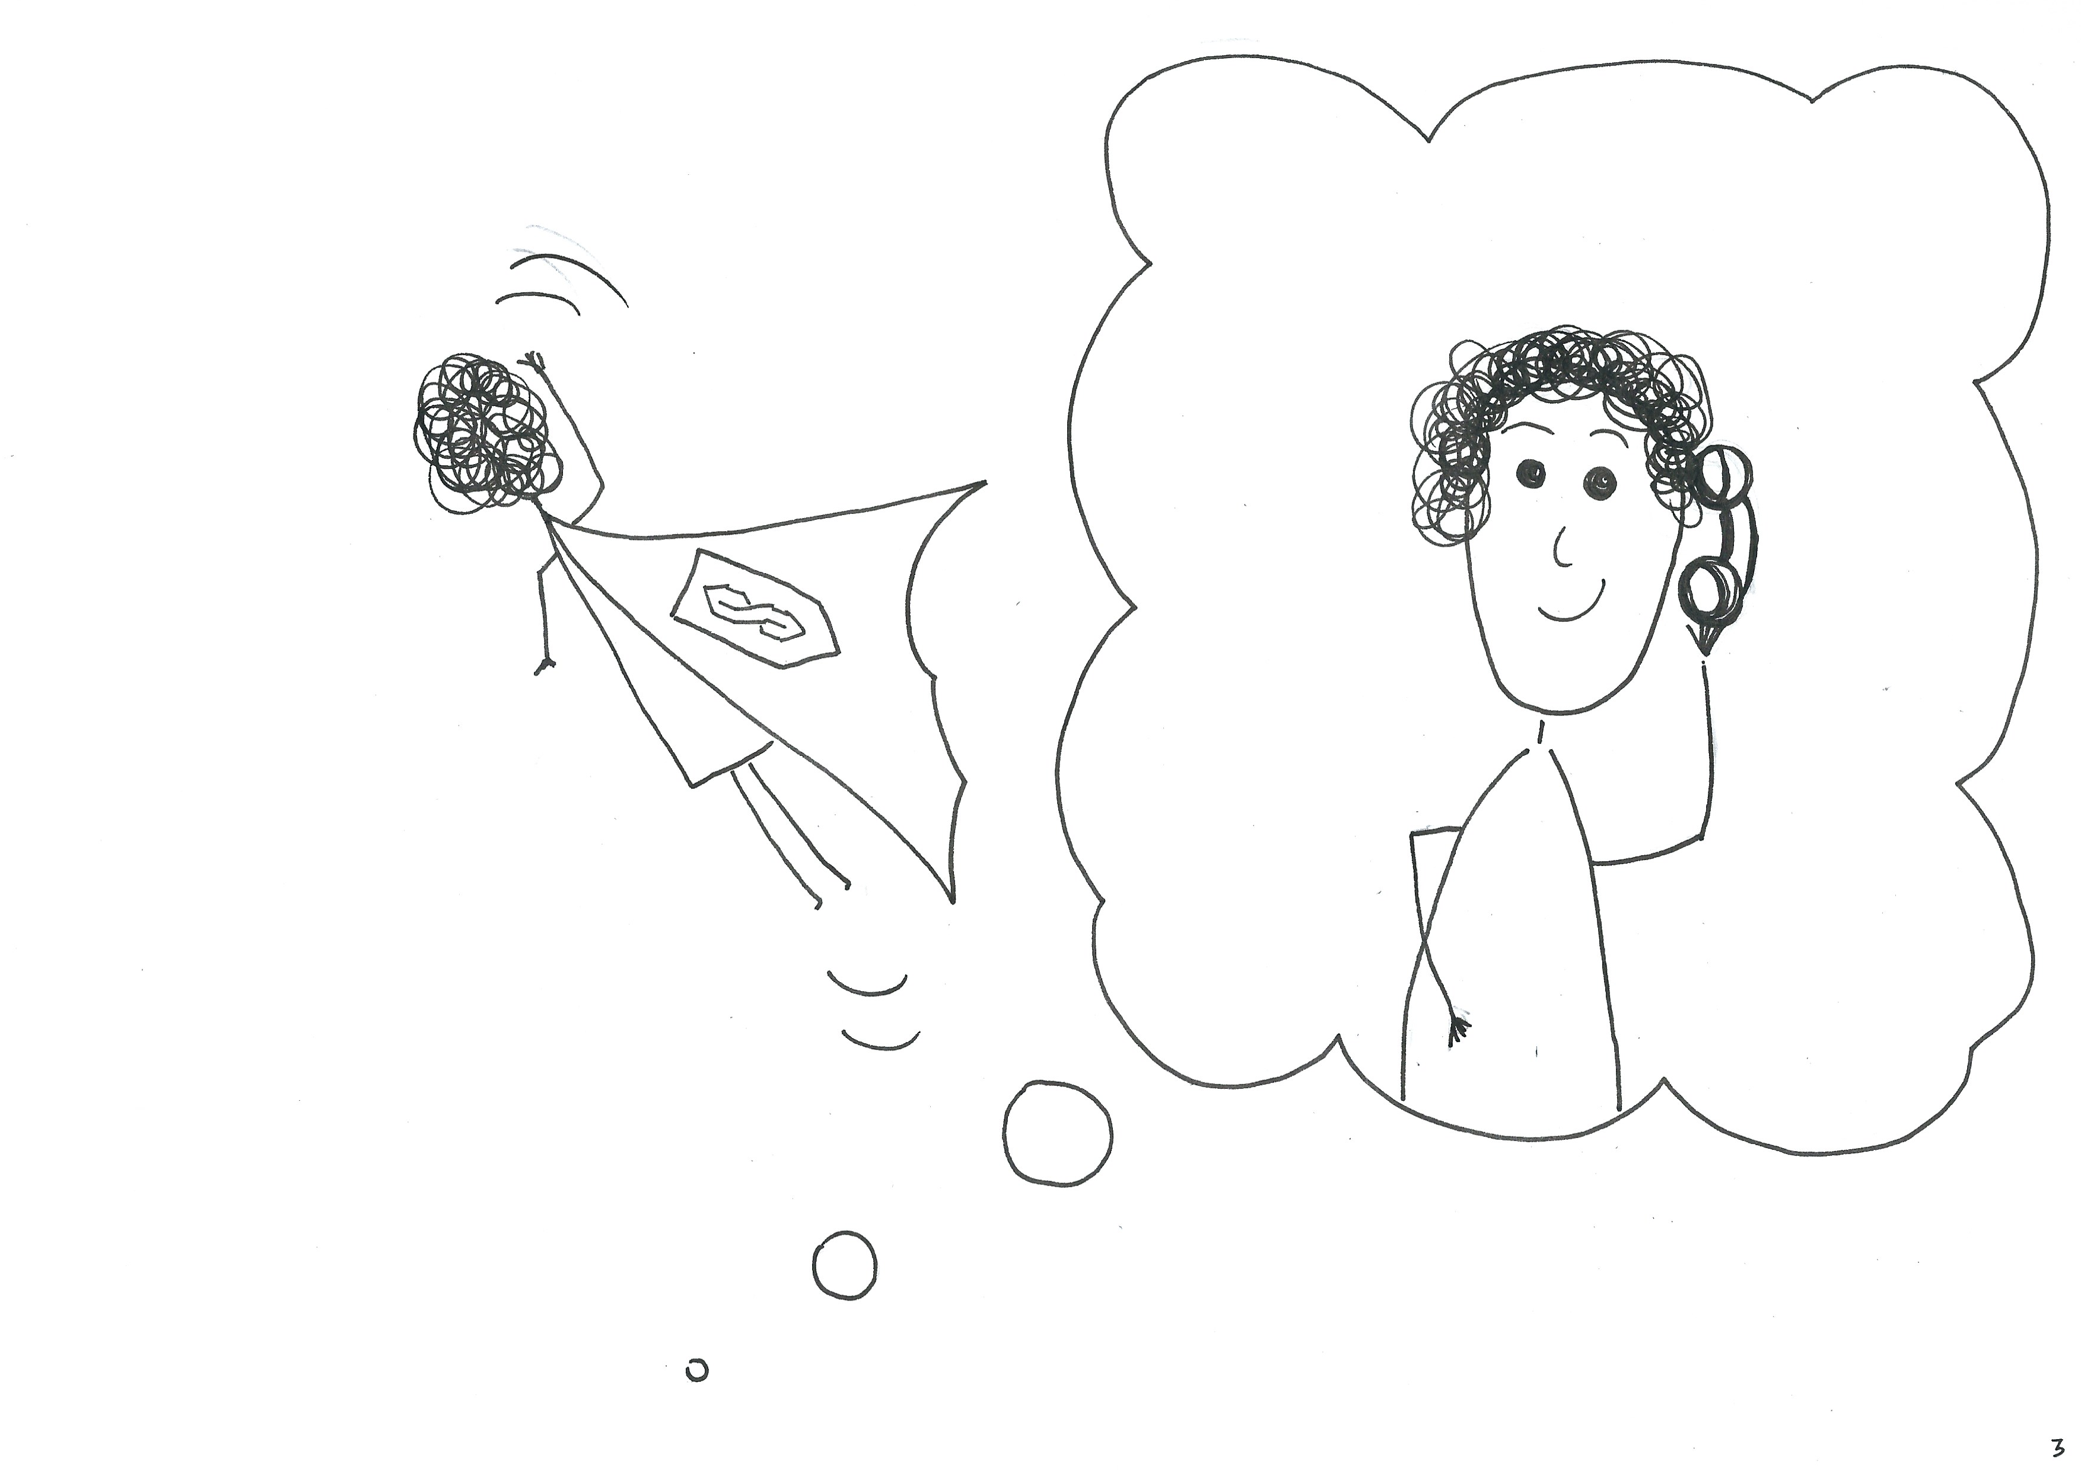
Notes:
Narrator: In flies Super Mum to help Alice.
Alice’s mum hates to see her upset, so acts immediately. She calls the school, and Tourette’s Action who arranges an assembly to educate on the condition.

Slide 5
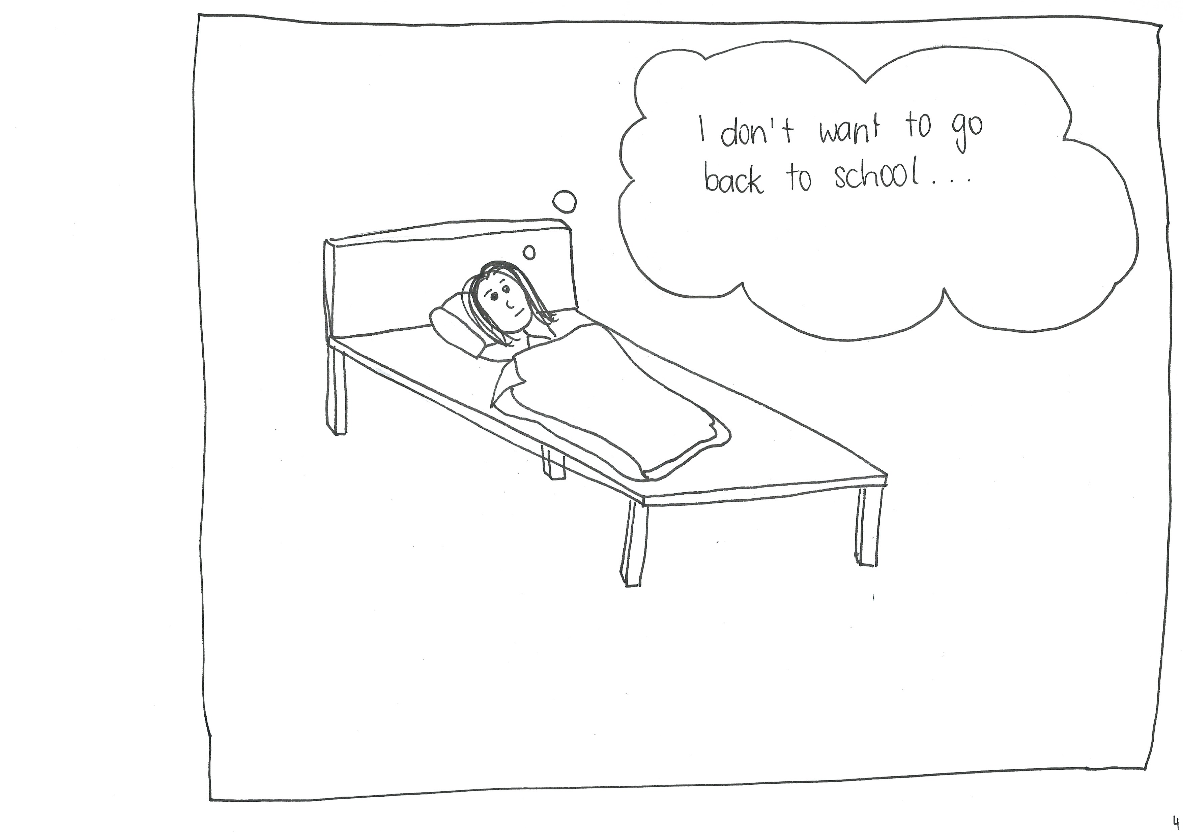
Notes:
Narrator: Despite Alice's mum putting the wheels in motion to get her help in school Alice isn't sure it would help. She is frustrated at being treated as stupid or naughty because she is noisy. The worst part about it all is that Alice is missing out on her education because other people don't understand her, she had spent more time outside the classroom this week than in it and has been 'sick' off school 2 times because she has not wanted to go in to face her teachers.

Slide 6
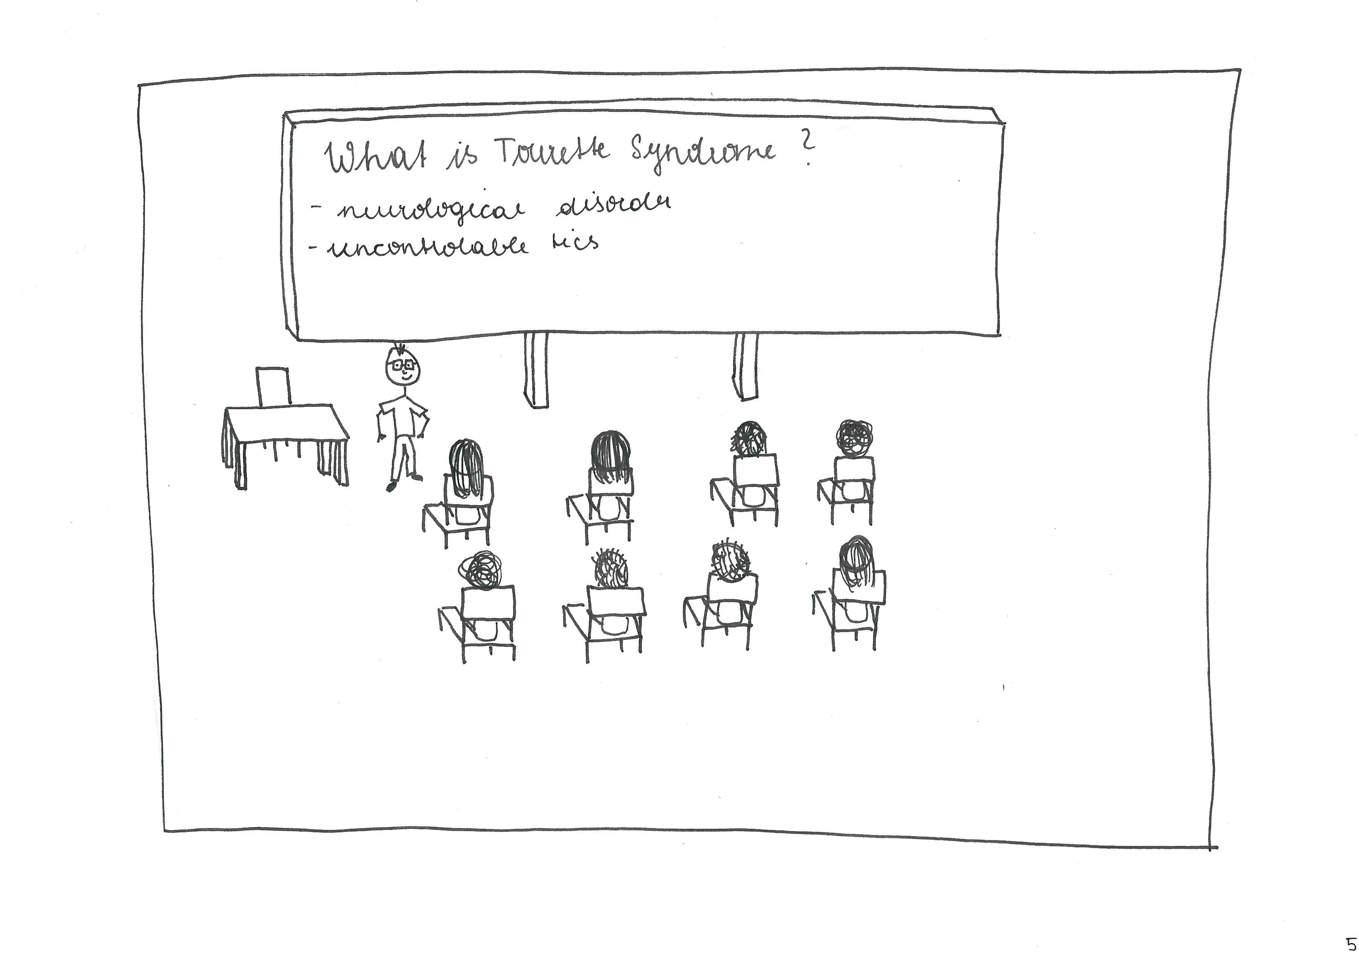
Notes:
Narrator: Tourette's Action comes to the school and shows a PowerPoint all about Tourette's, how it affects people and how they can support Alice, be a good friend and teacher. They know now that it is ok to ask Alice questions about her condition, to ignore her tics in the classroom and that doing things that she enjoys and being around her friends can make her tics better. When Alice is stressed her tics may become worse, here she needs to have a break, she also had the chance to tell her friends and teachers that she doesn't mean what she says when she tics and never wants to offend anyone. They were interested to find out that although Alice had coprolalia (Compulsive swearing), only 10-15% of people with Tourette's have this, so despite what people might think, Tourette's really isn't the swearing disorder.

Slide 7
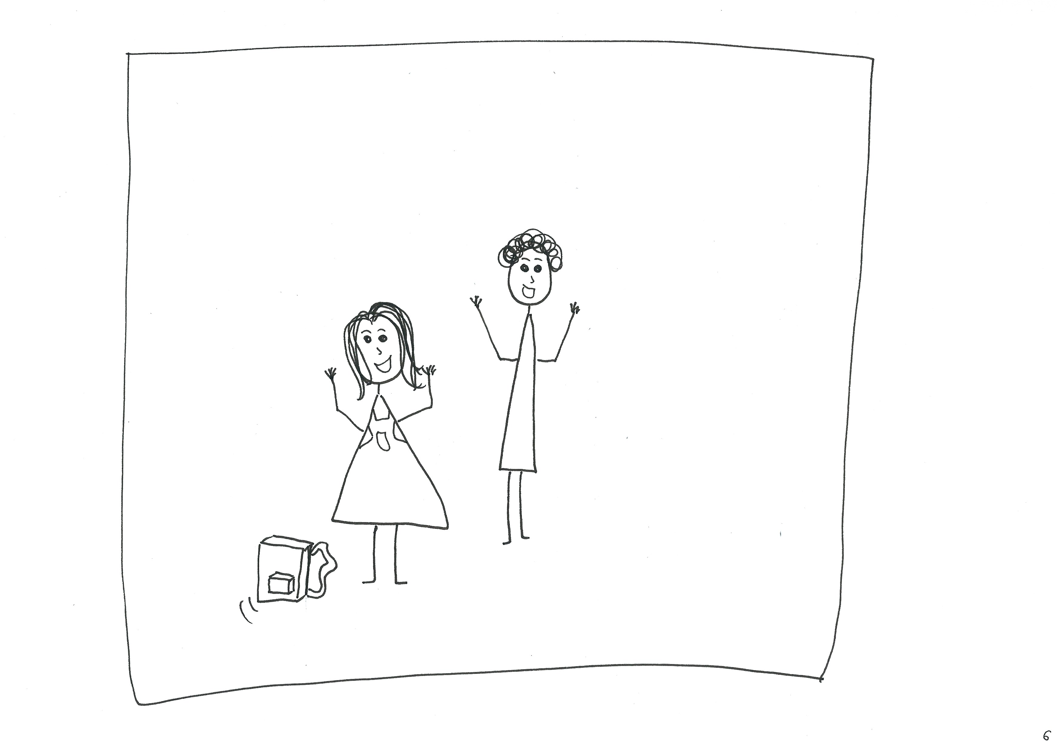
Notes:
Alice comes home the following week.
Mum: How was today then my love?
Alice: It was so much better mum, Anna, Sheila, Pam and I went to the field for lunch. My teacher let me outside for a break in the middle of the lesson as I was getting a little over stimulated. I'm going to join the drama club and I am applying to be a peer mentor next year supporting other student with different abilities. I feel so much more accepted now.

Slide 8
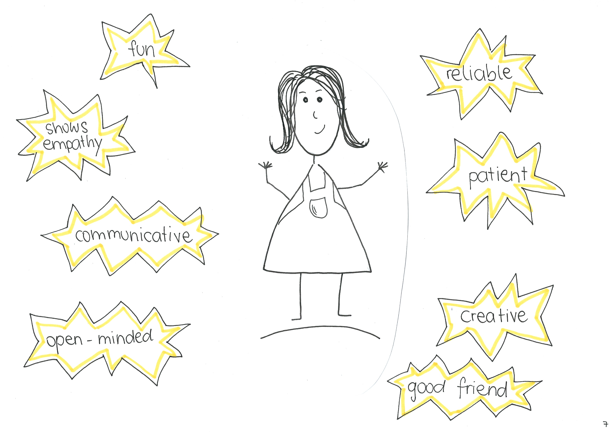
Notes:
Alice: Now people focus more on my resources and strengths

Slide 9
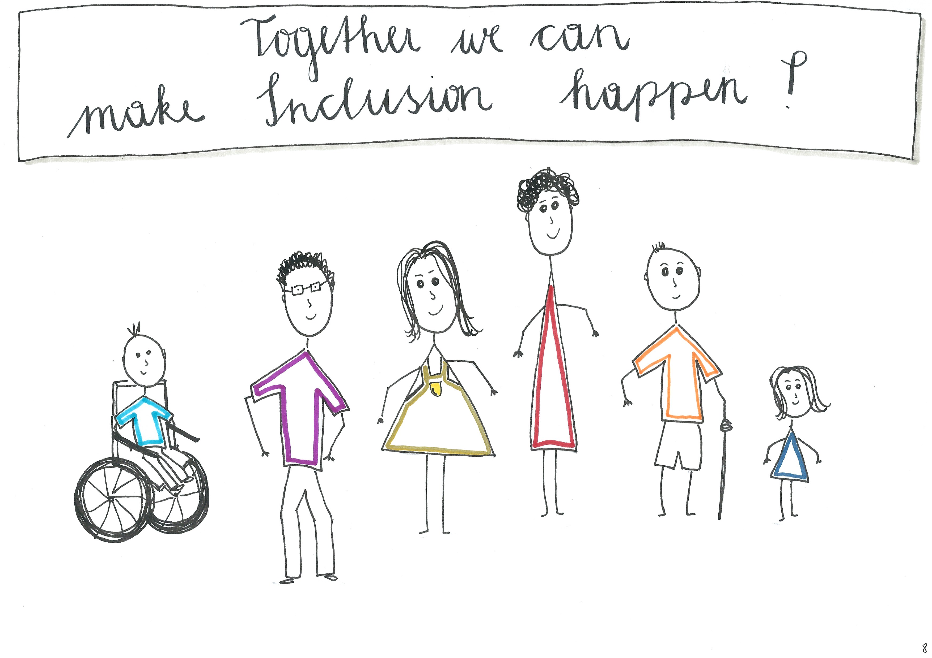
Notes:
Narrator: The worst thing about disability is people see it before they see you. Lets work together to change this.

